Slide 1

THIS OR THAT
THIS OR THAT

Slide 2

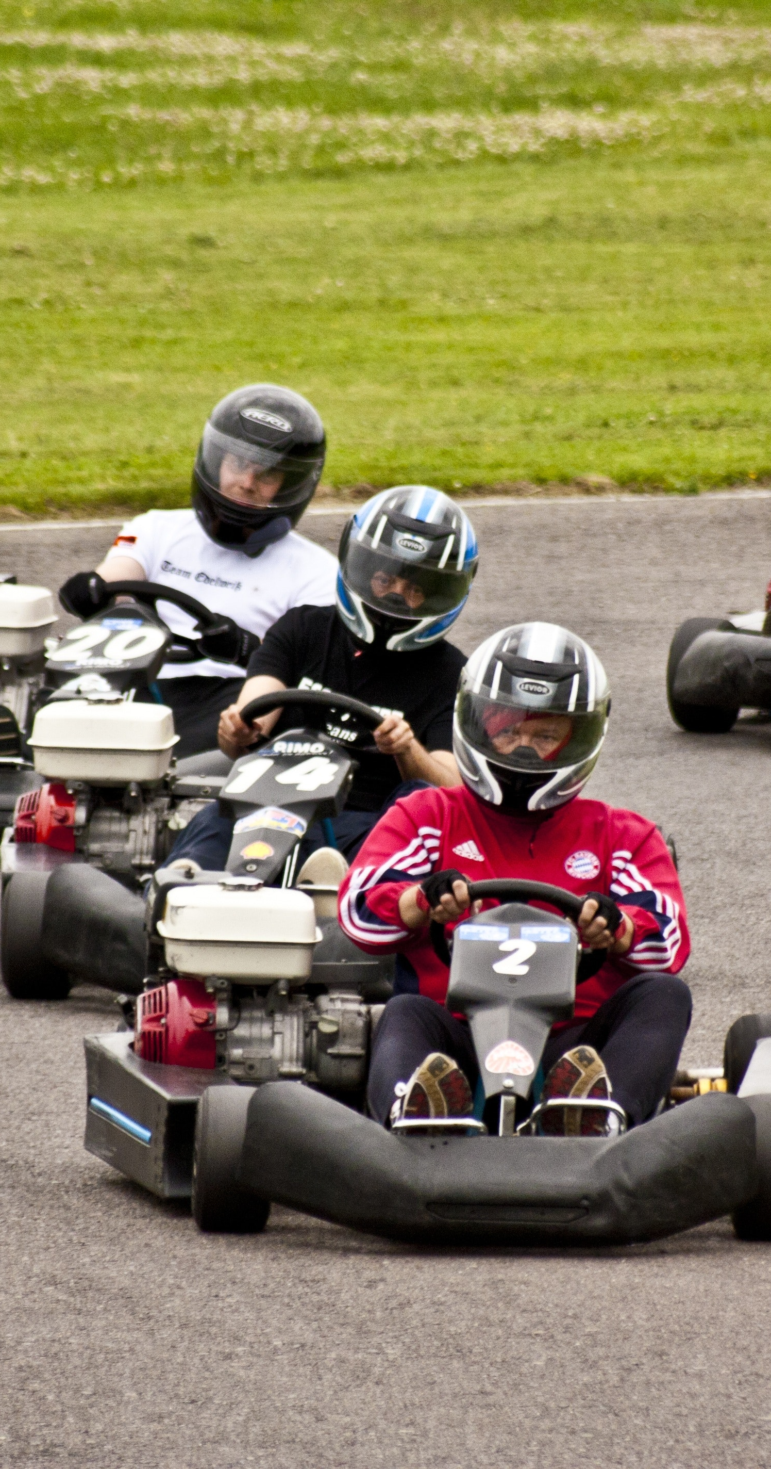
LASER TAG
TEST RUN
GO KARTS
RULES
LOCATE AREA 1 AND AREA 2.
THE PICTURE ON THE LEFT WILL REPRESENT AREA 1 AND THE PICTURE ON THE RIGHT WILL REPRESENT AREA 2.
ON THE INSTRUCTOR'S DIRECTIVE GO TO THE RESPECTIVE AREA BASED ON THE CONCEPT YOU PREFER THE MOST (YOU CAN ONLY CHOOSE ONE).
YOU HAVE 5 SECONDS TO GET TO EACH AREA WHEN THE SLIDE CHANGES.

Slide 3
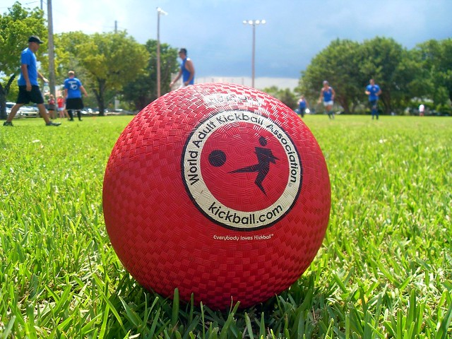
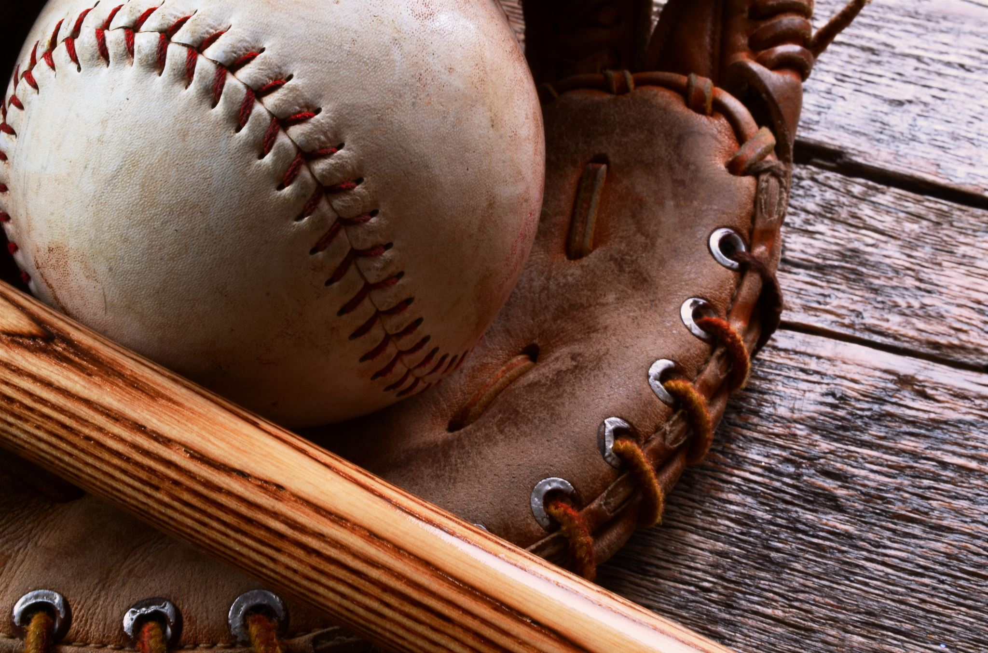
KICKBALL
SOFTBALL

Slide 4
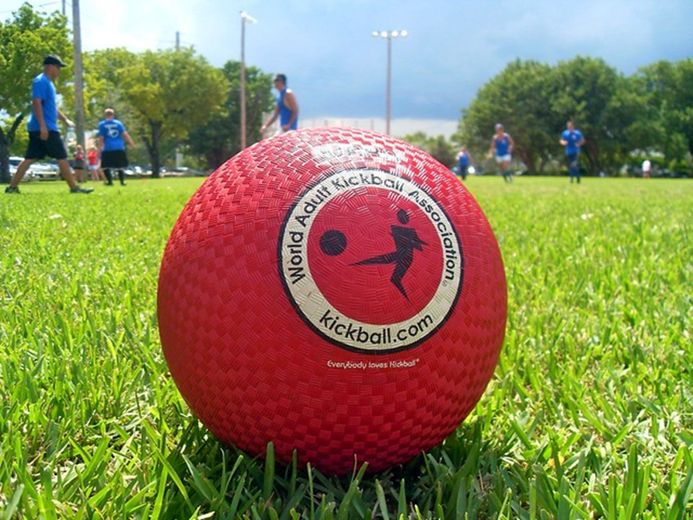

DODGEBALL
KICKBALL

Slide 5


RED LIGHT GREEN LIGHT
SHARKS + MINNOWS

Slide 6


ULTIMATE FRISBEE
LACROSSE

Slide 7

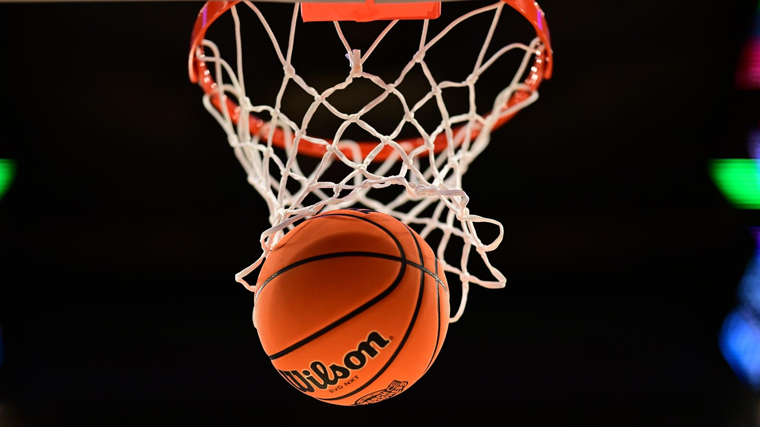
SOCCER
BASKETBALL

Slide 8


TEXT
CALL (TALK)

Slide 9


TUBI
DISNEY PLUS+

Slide 10


SPOTIFY
APPLE MUSIC

Slide 11
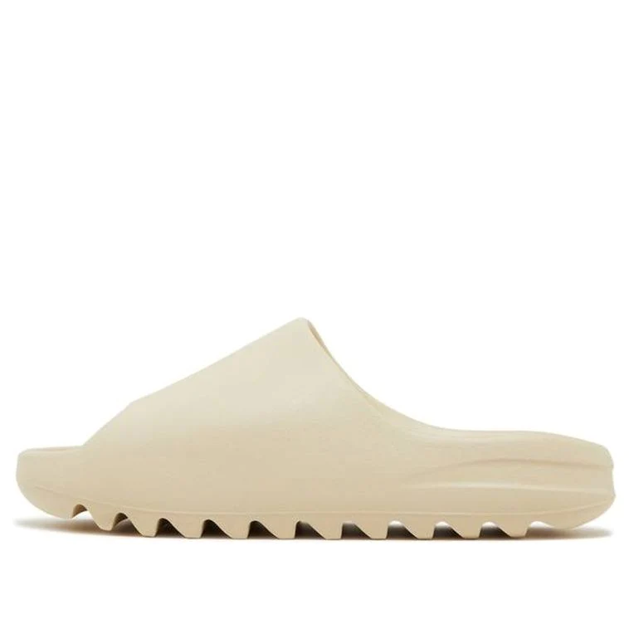
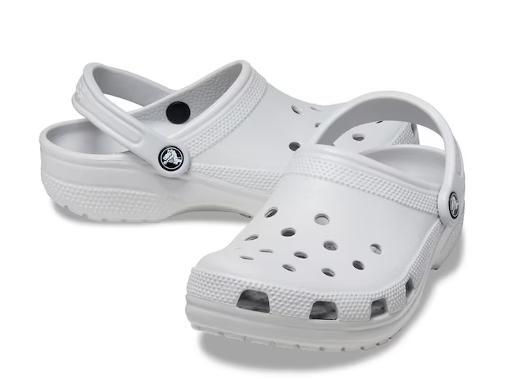
CROCS
YEEZY SLIDES

Slide 12
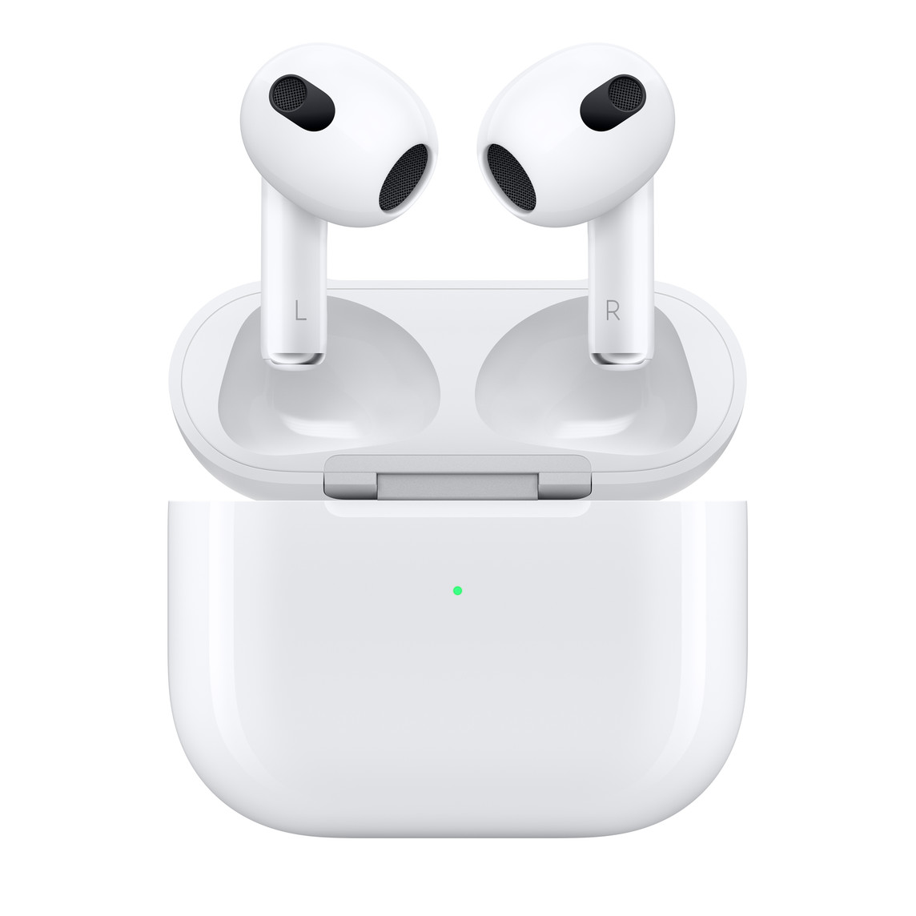
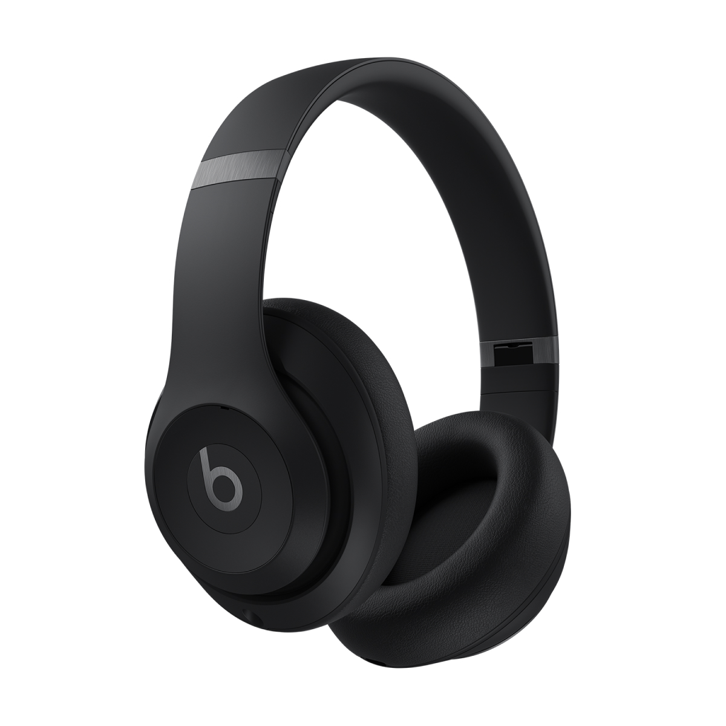
AIR PODS
EARPHONES

Slide 13
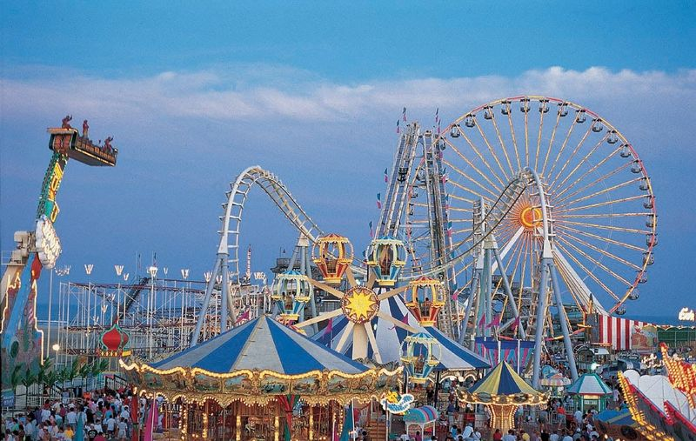
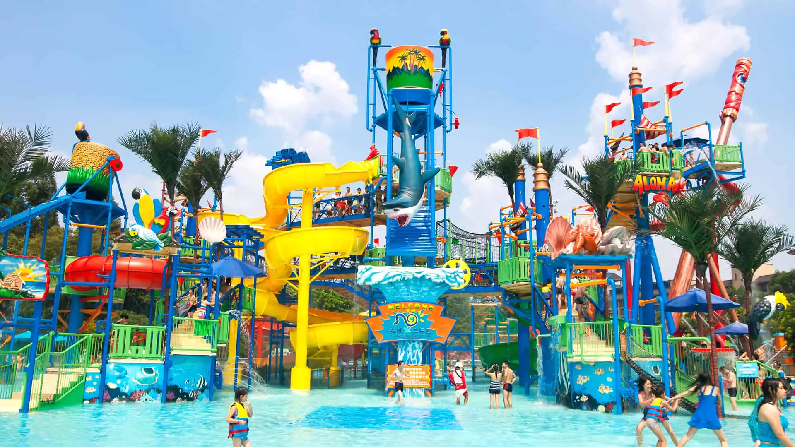
WATER PARK
AMUSEMENT PARK

Slide 14
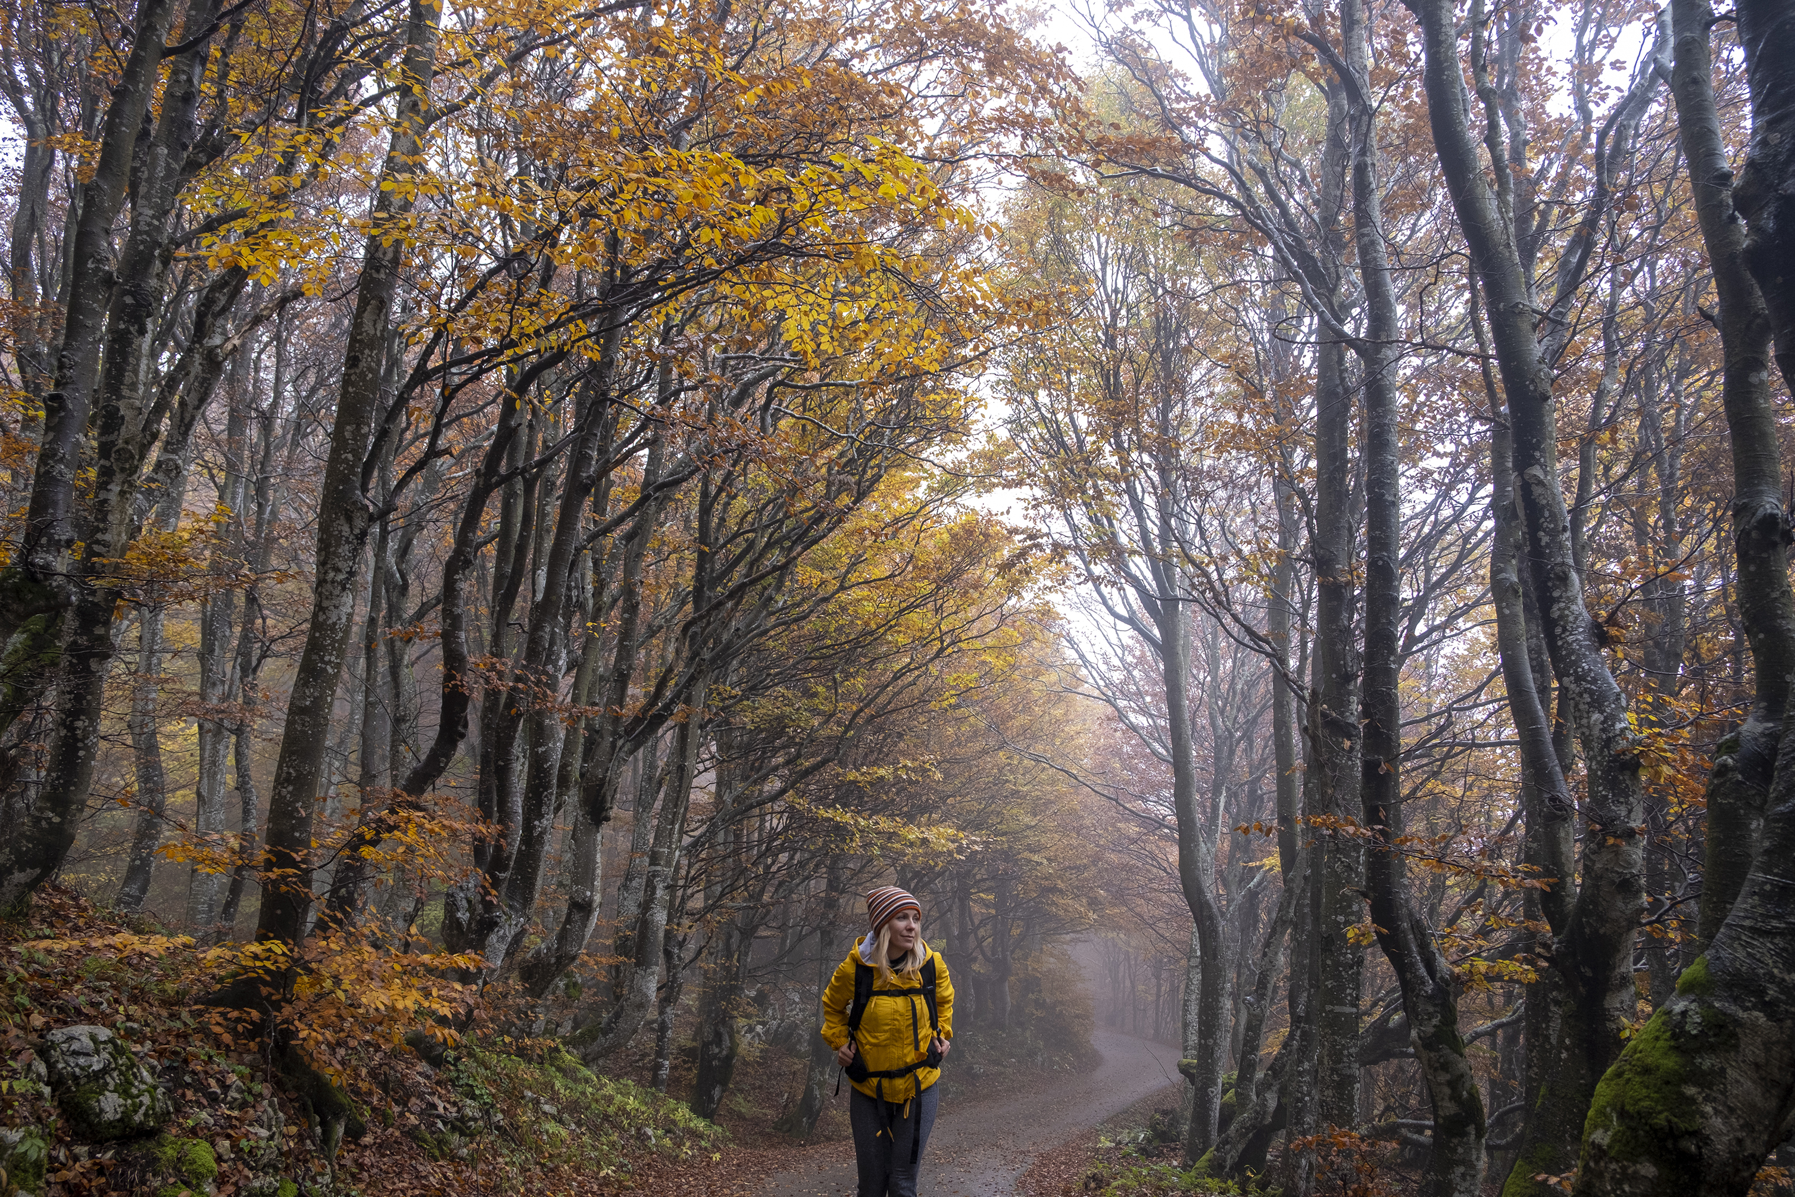

OUTDOORS
INDOORS

Slide 15


FISHING
BINGE WATCH NETFLIX

Slide 16
Calisthenics is a form of exercise that uses a person's body weight and requires little to no equipment.

Slide 17

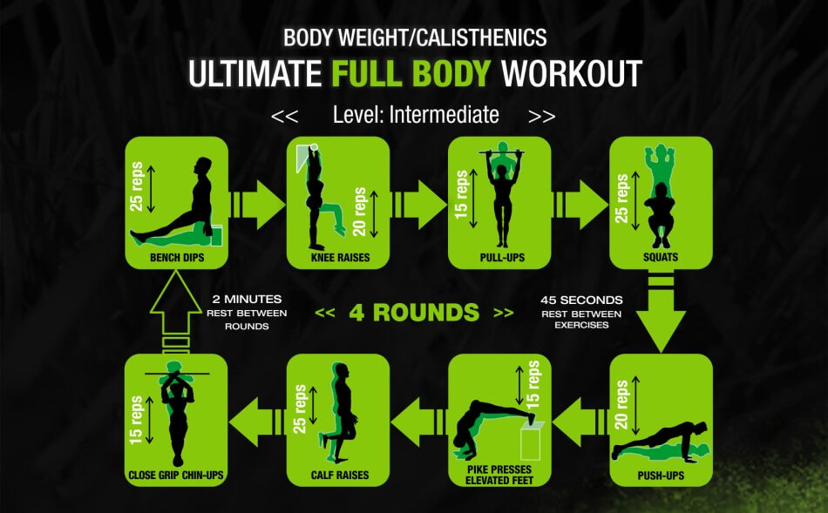
CALSTENICS
LIFT WEIGHTS

Slide 18

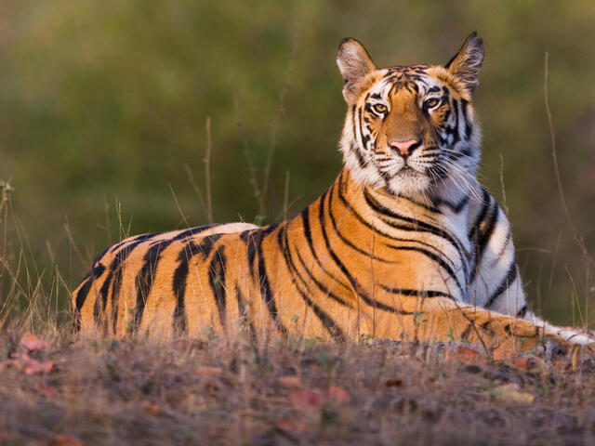
LION
TIGER

Slide 19
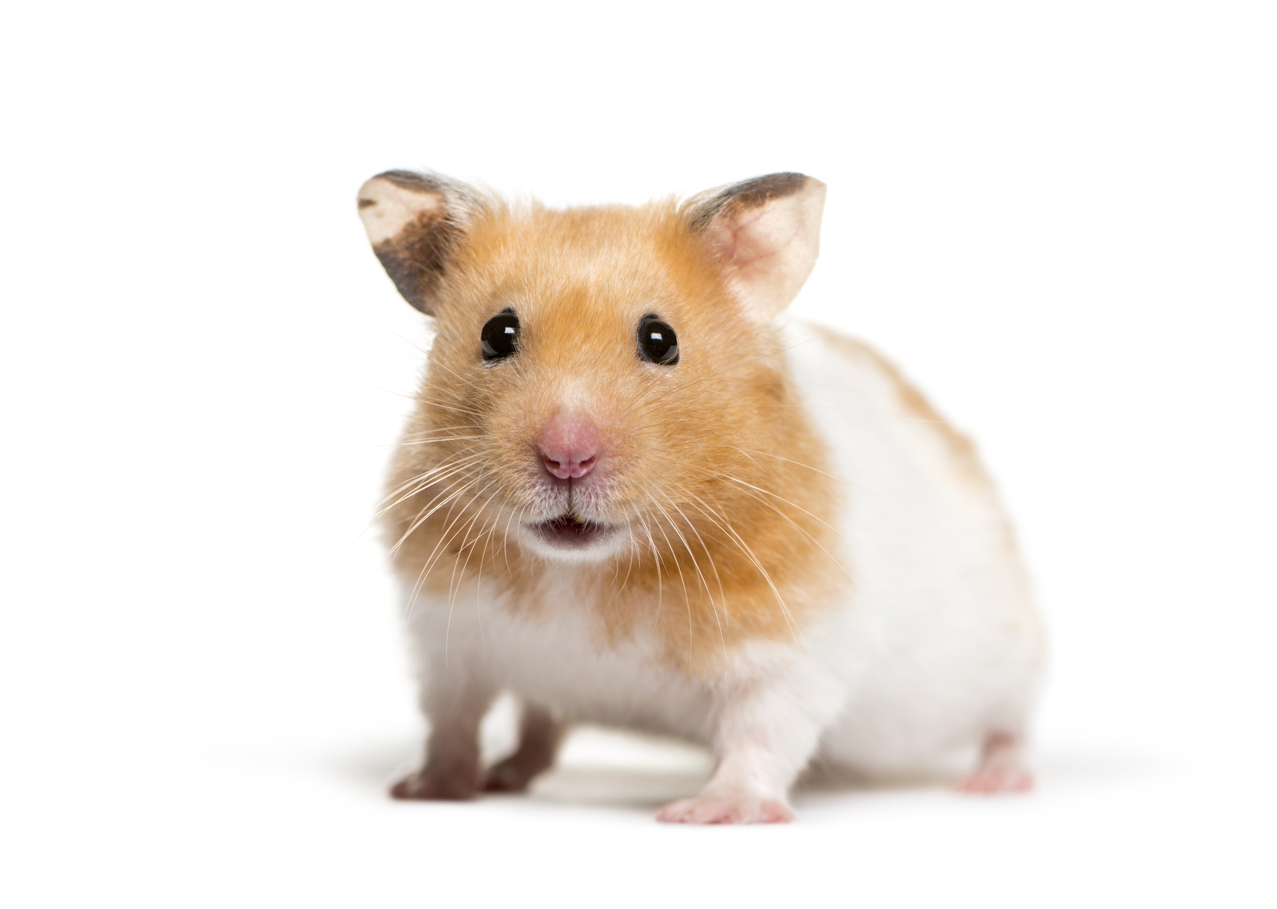
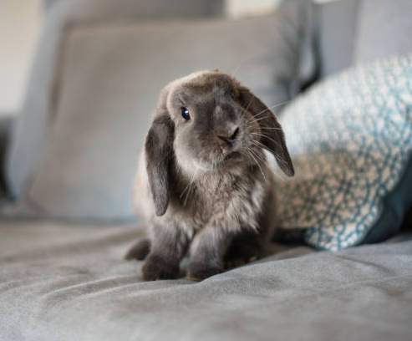
PET RABBIT
PET HAMSTER

Slide 20


CALL OF DUTY
POKEMON

Slide 21
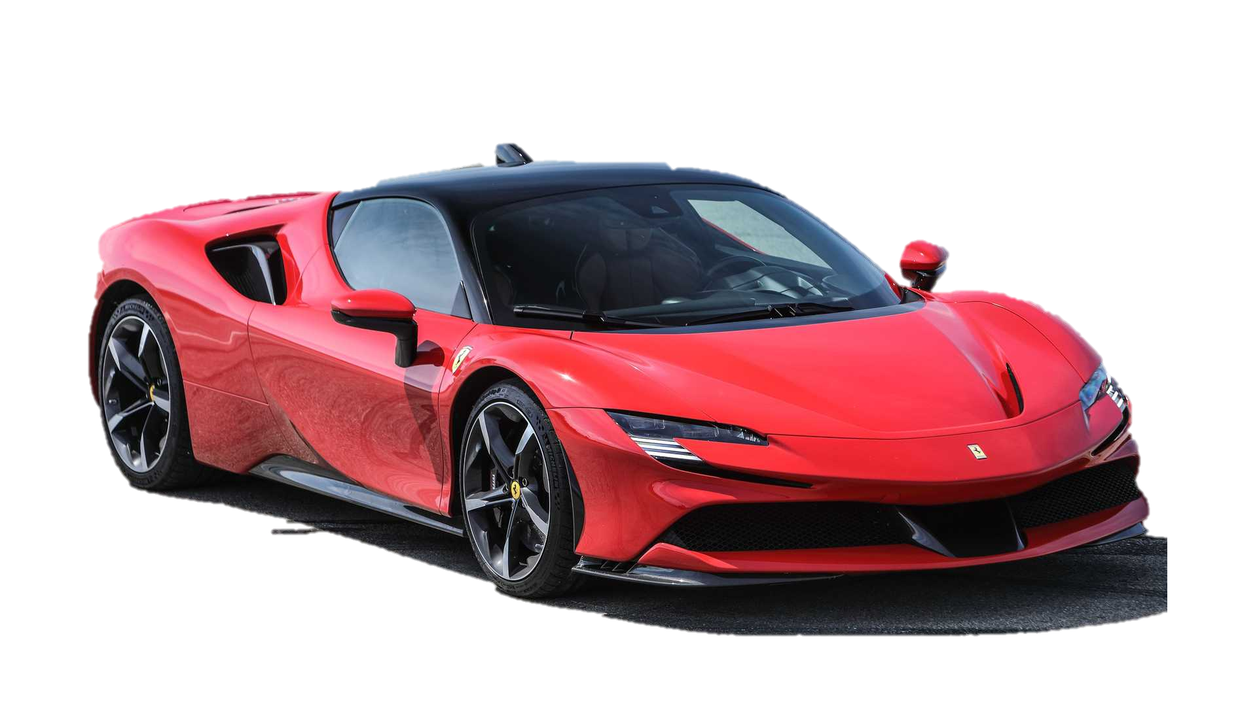
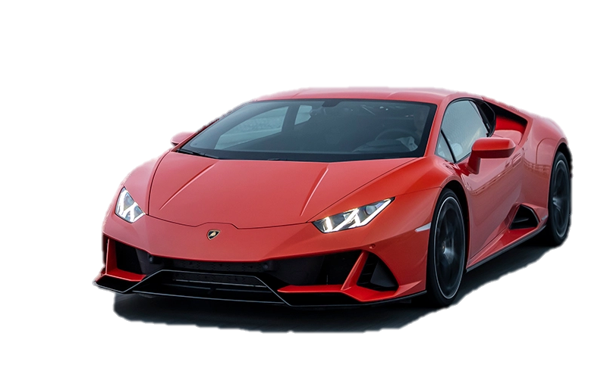
FERRARI
LAMBORGHINI

Slide 22
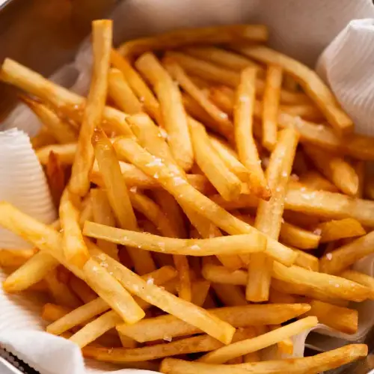
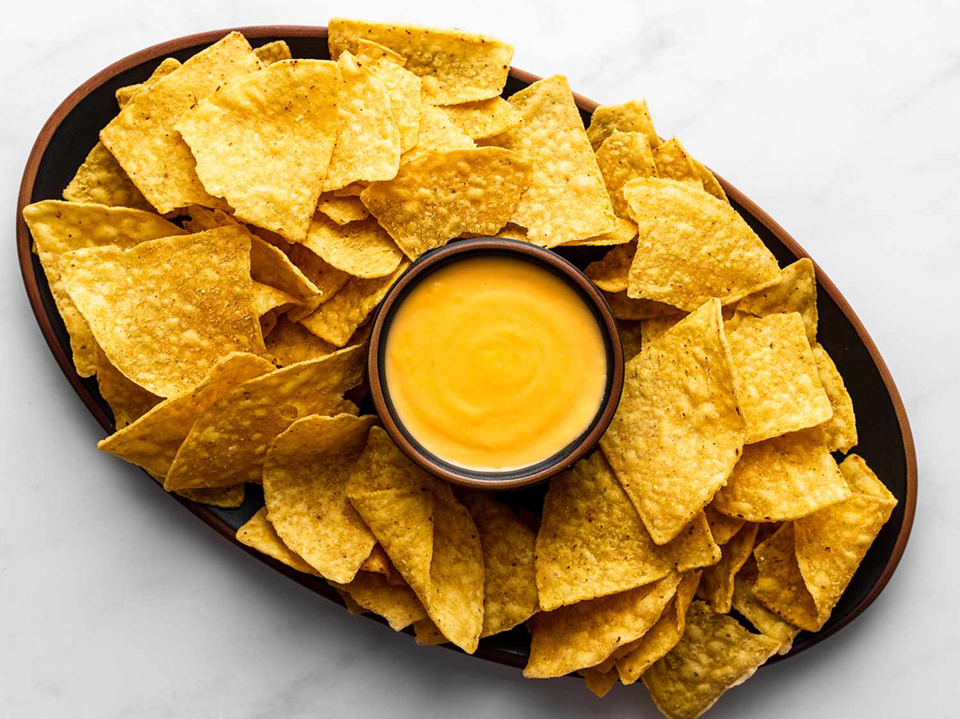
FRIES
NACHOS

Slide 23
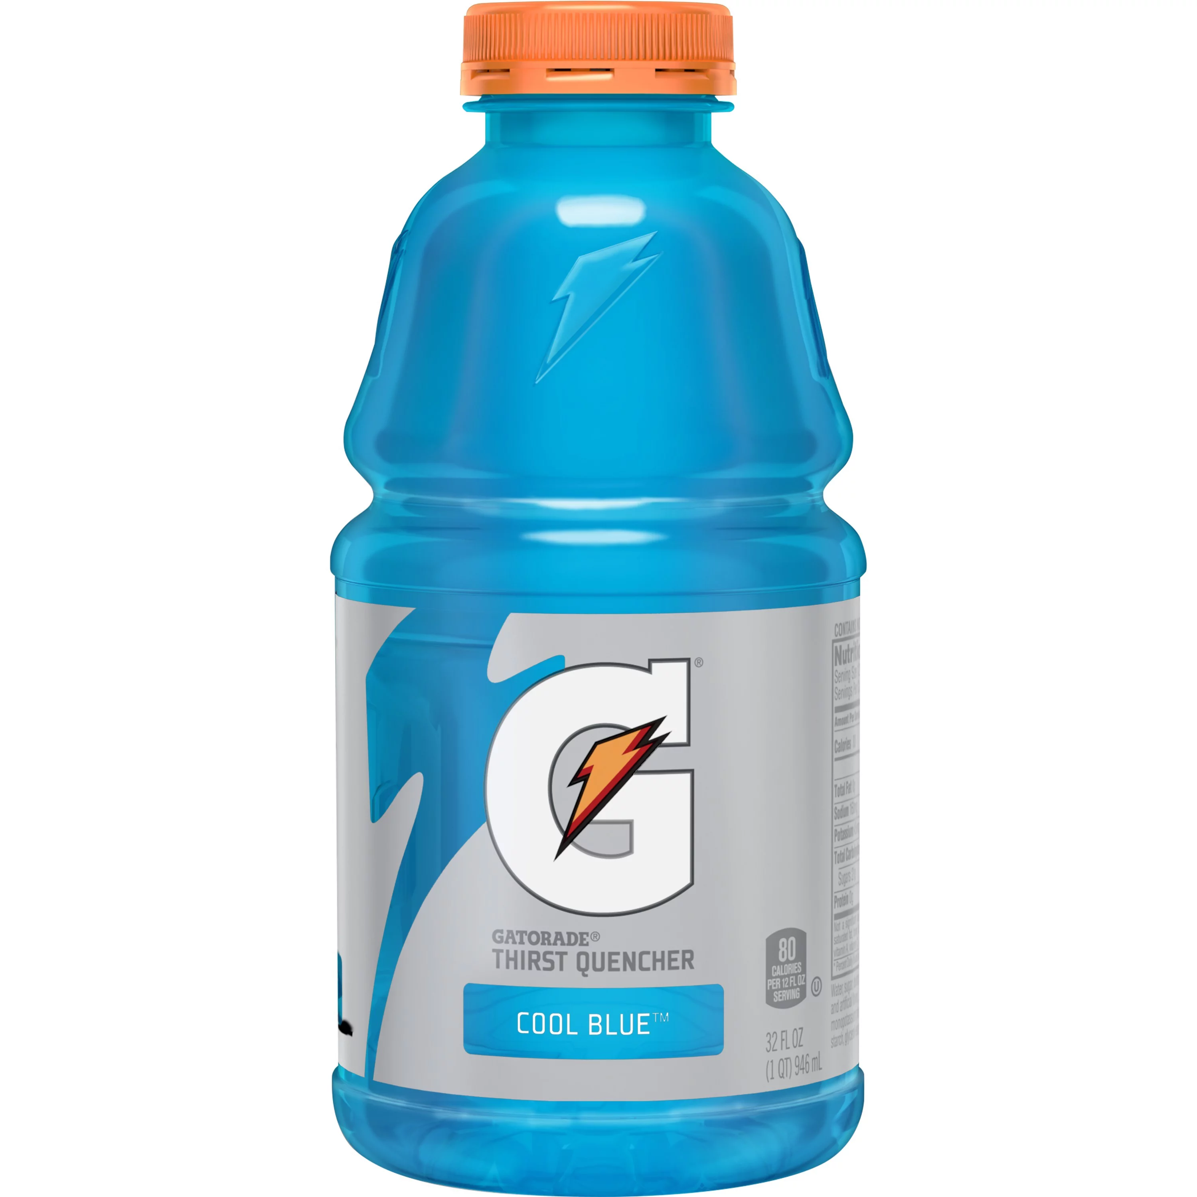
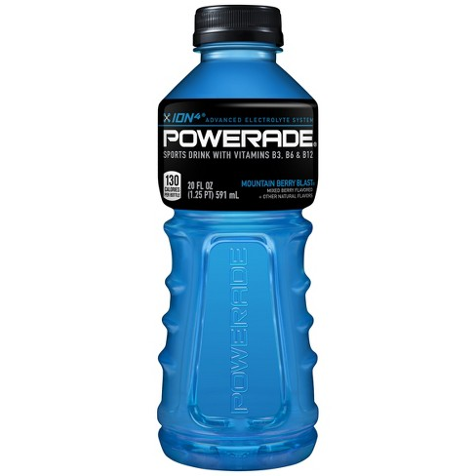
GATORADE
POWERADE

Slide 24
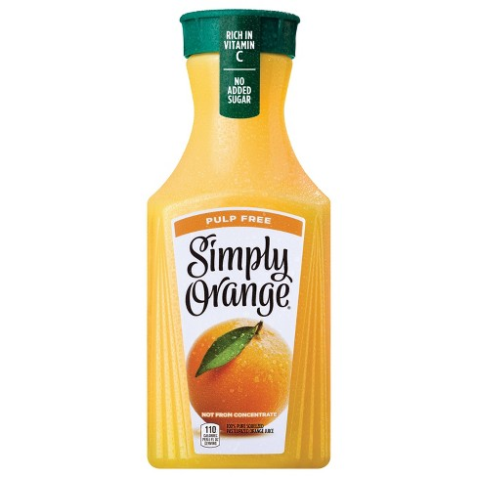
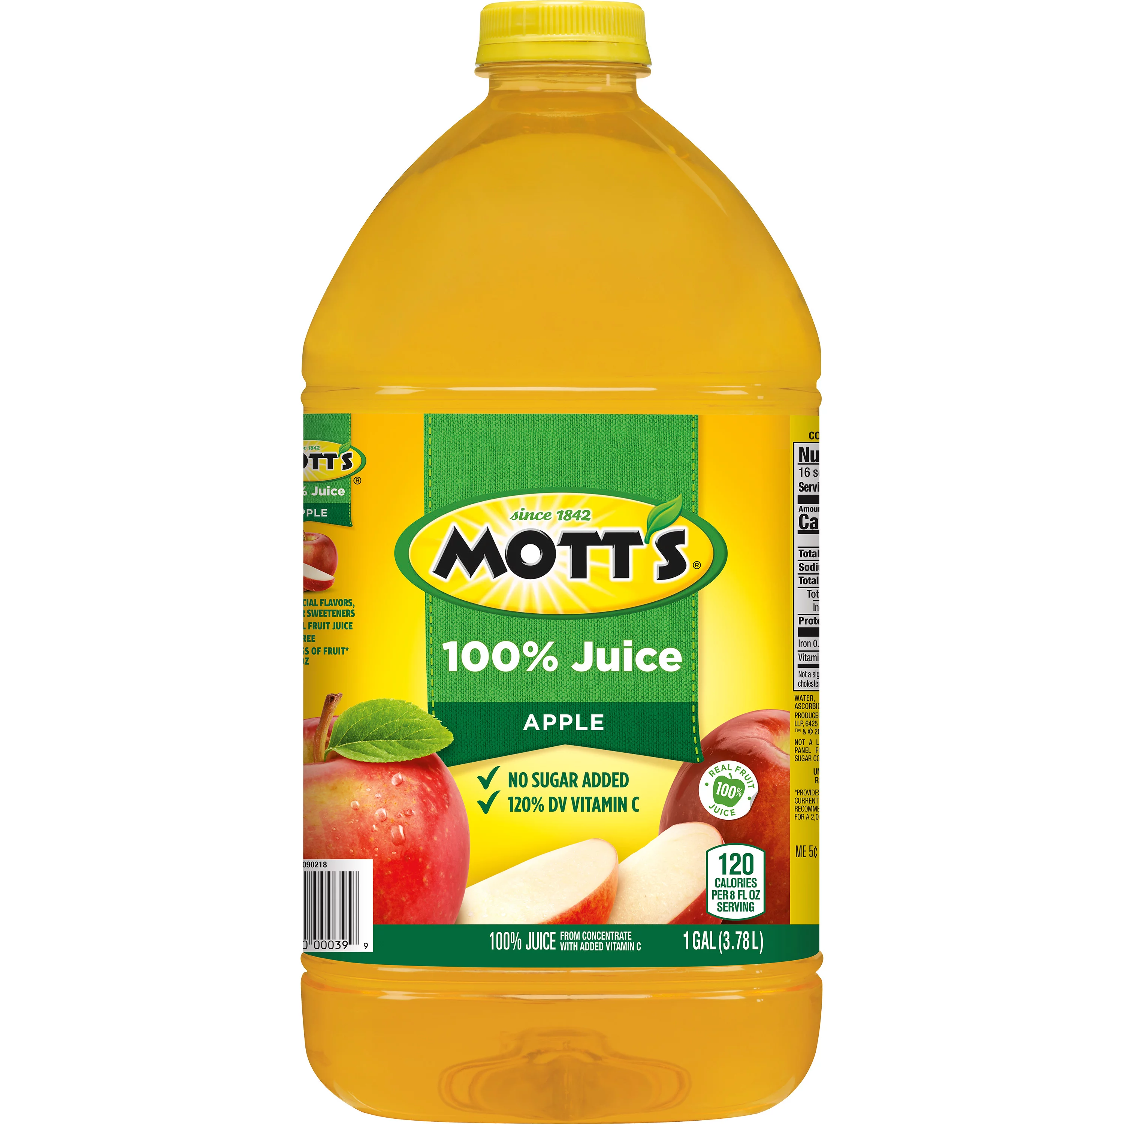
APPLE JUICE
ORANGE JUICE

Slide 25


PANDA EXPRESS
WING STOP

Slide 26

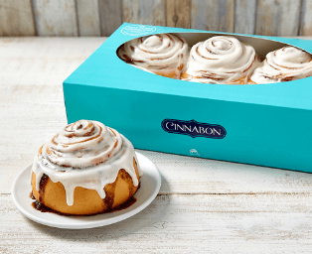
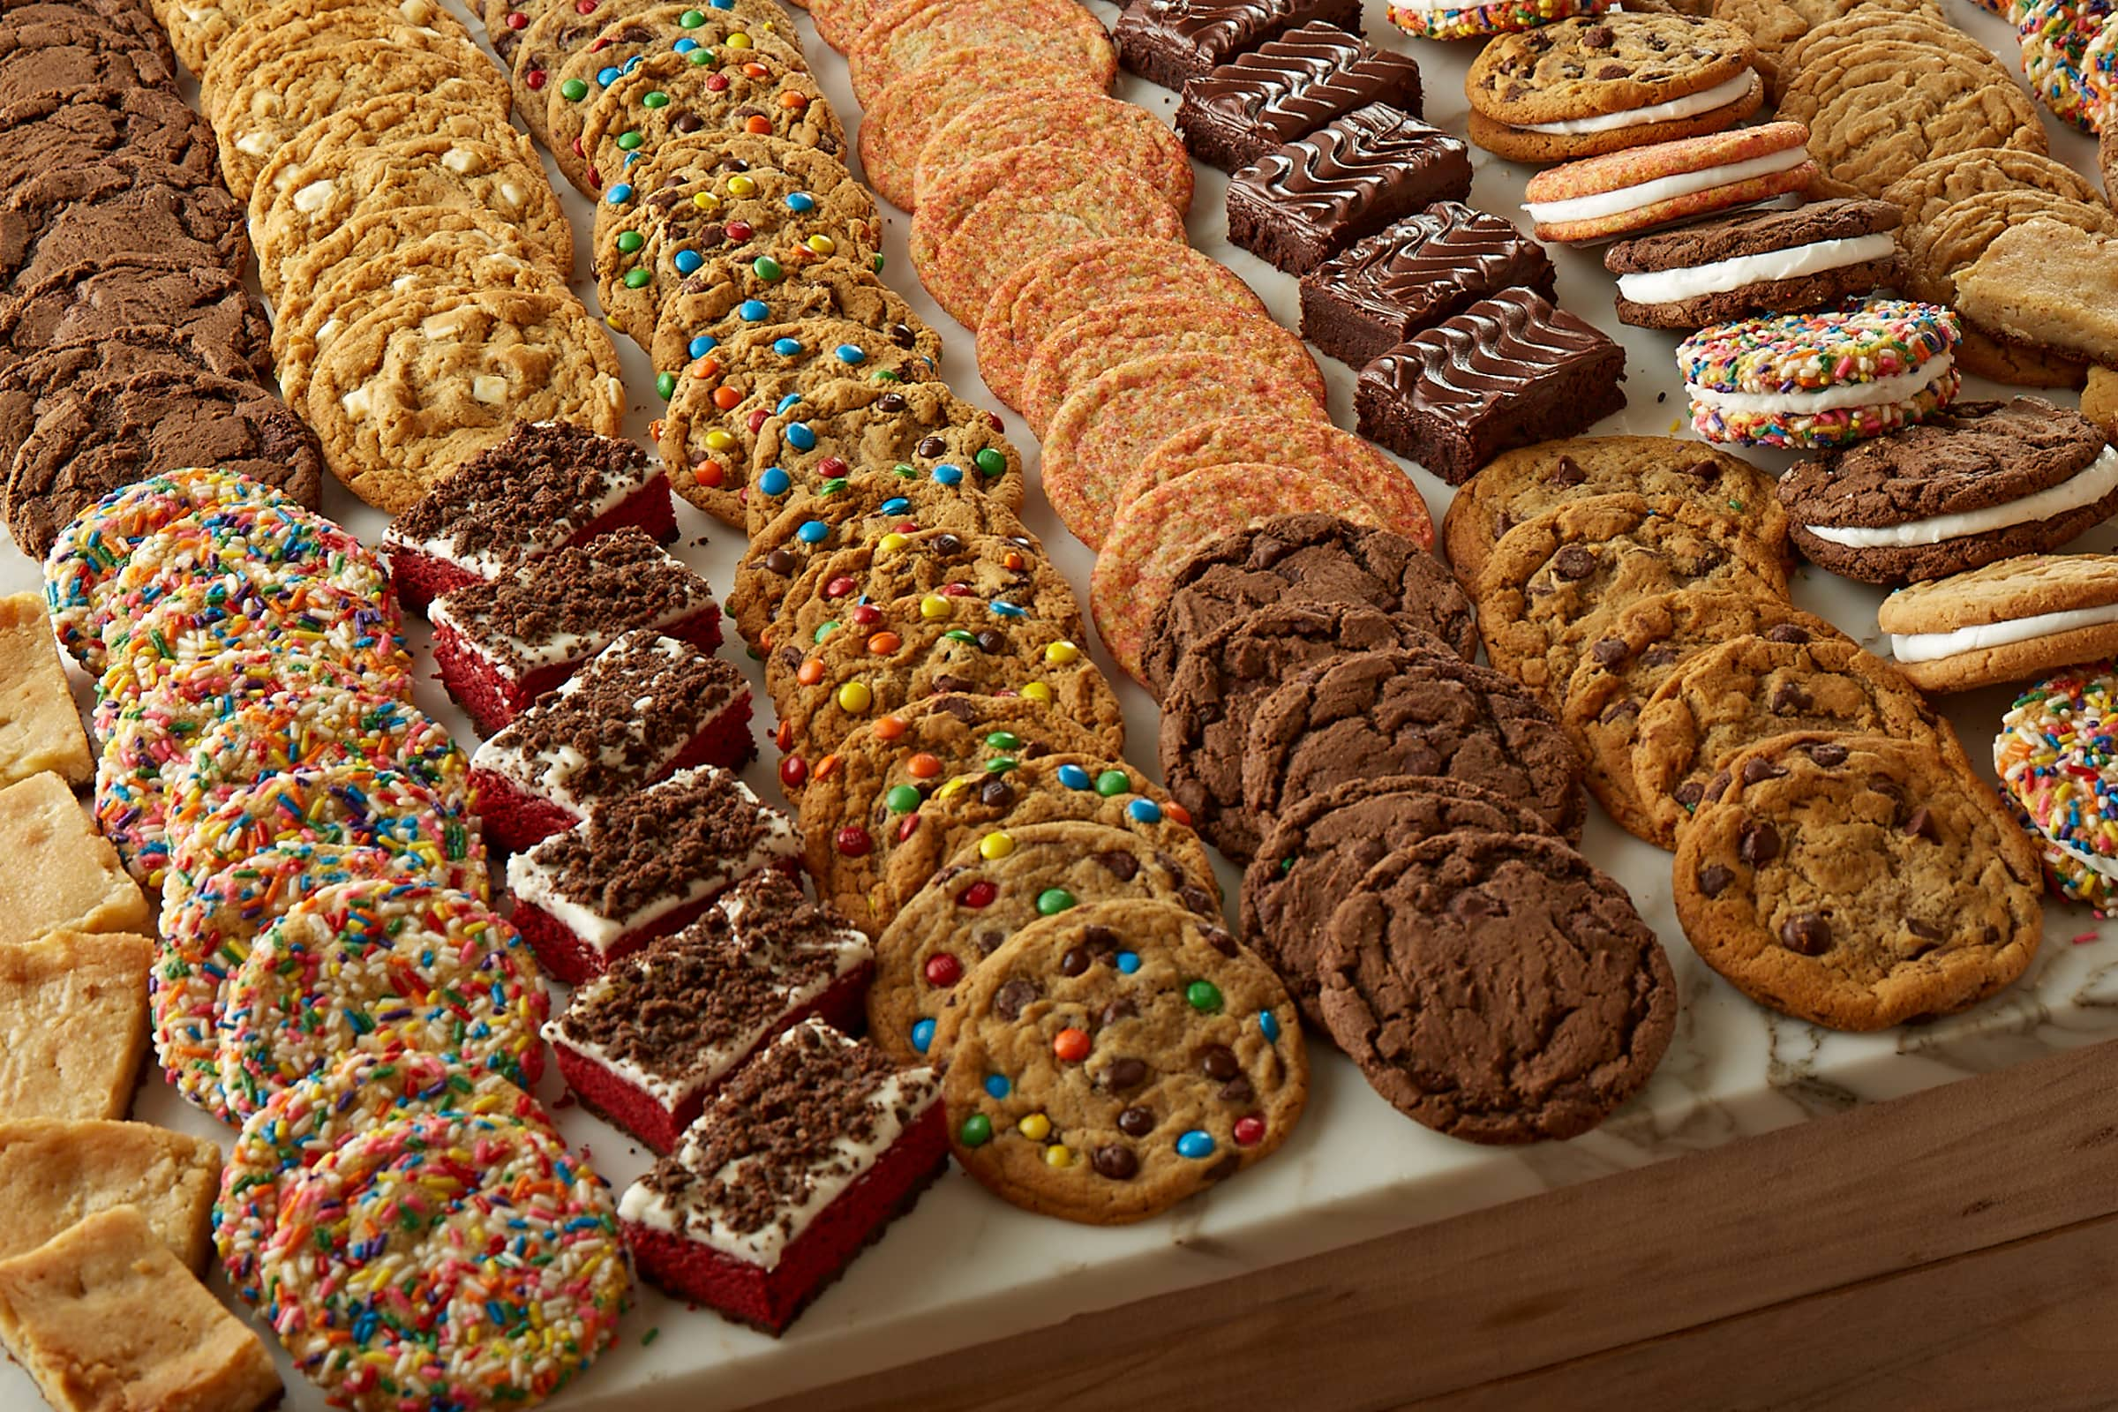
GREAT AMERICAN COOKIE
CINNABON

Slide 27
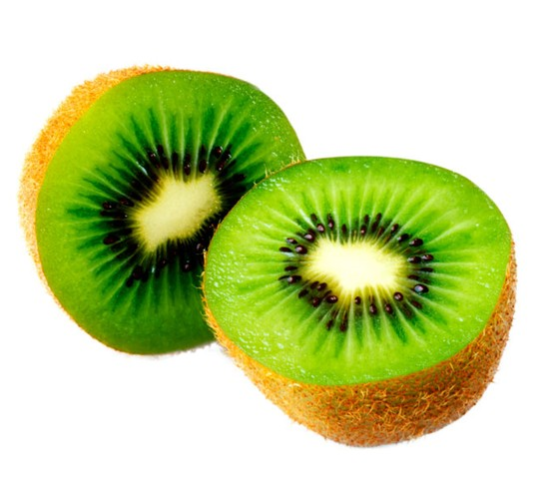

KIWI
PINEAPPLE

Slide 28
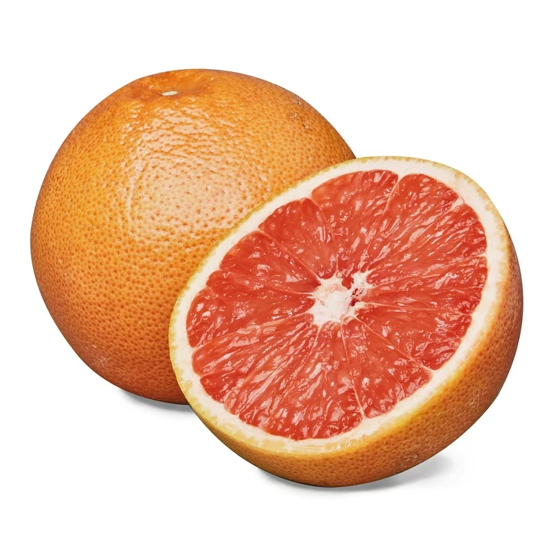
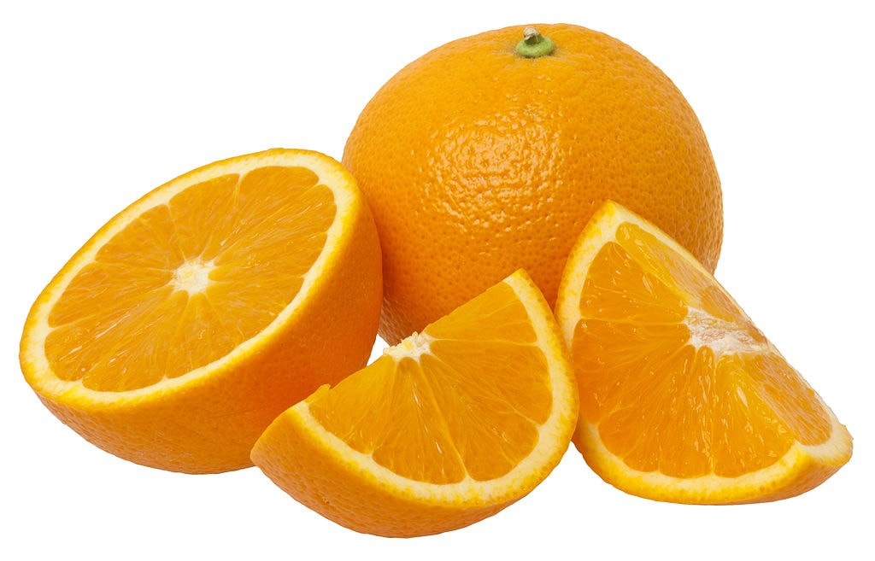
GRAPEFRUIT
ORANGE

Slide 29

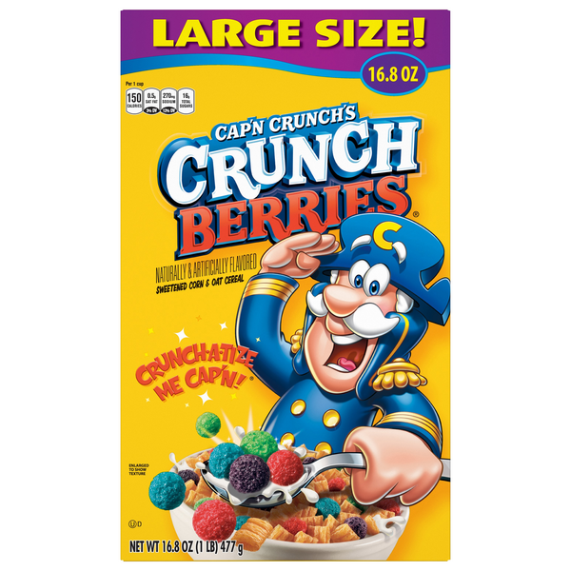
LUCKY CHARMS
CAP’N CRUNCH

Slide 30
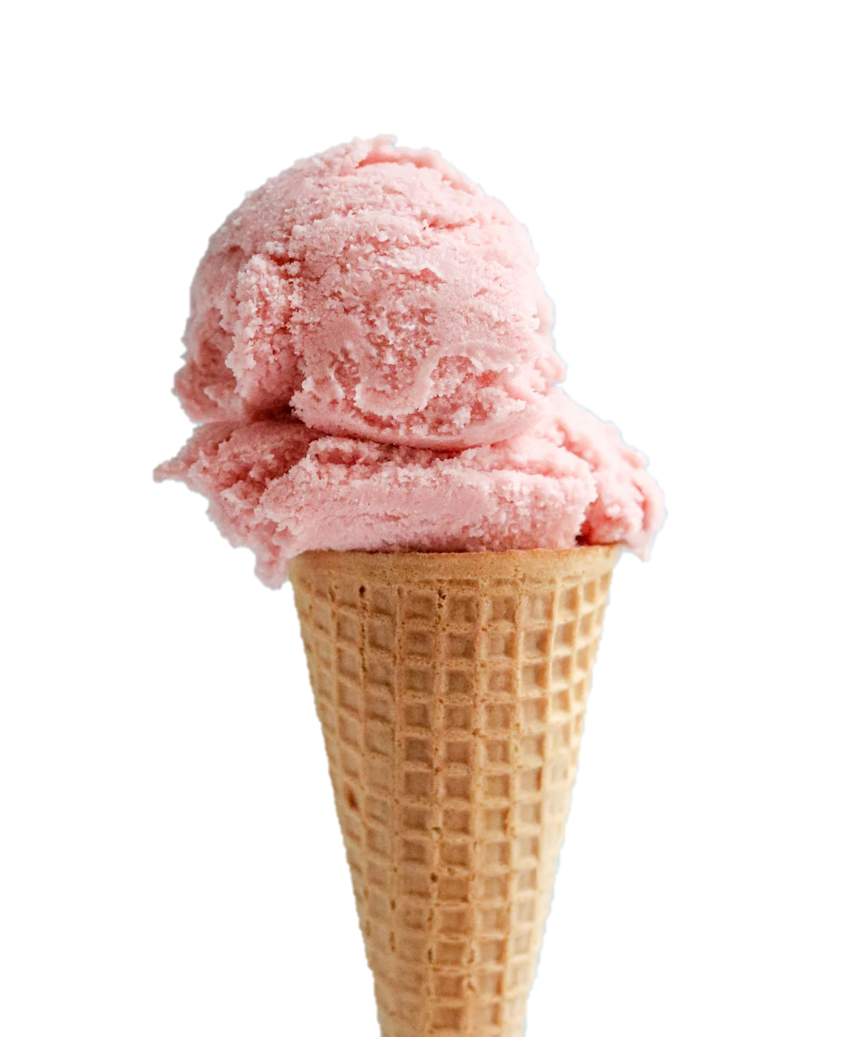
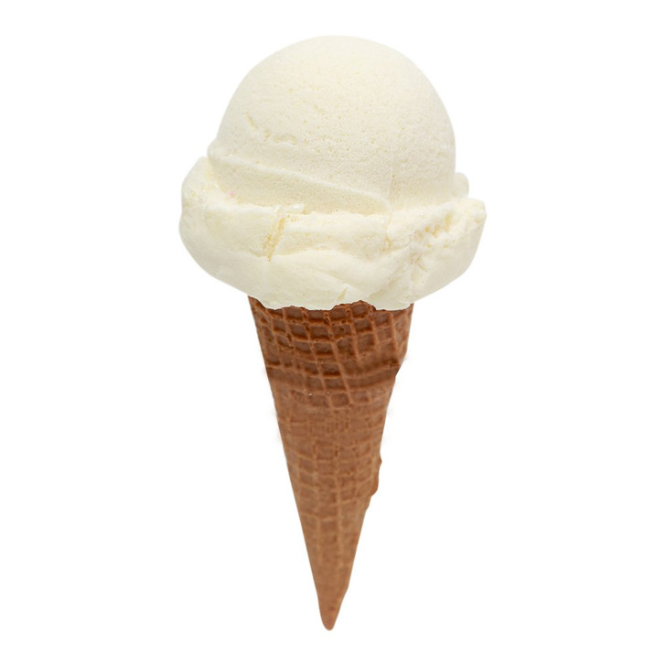
VANILLA
STRAWBERRY

Slide 31
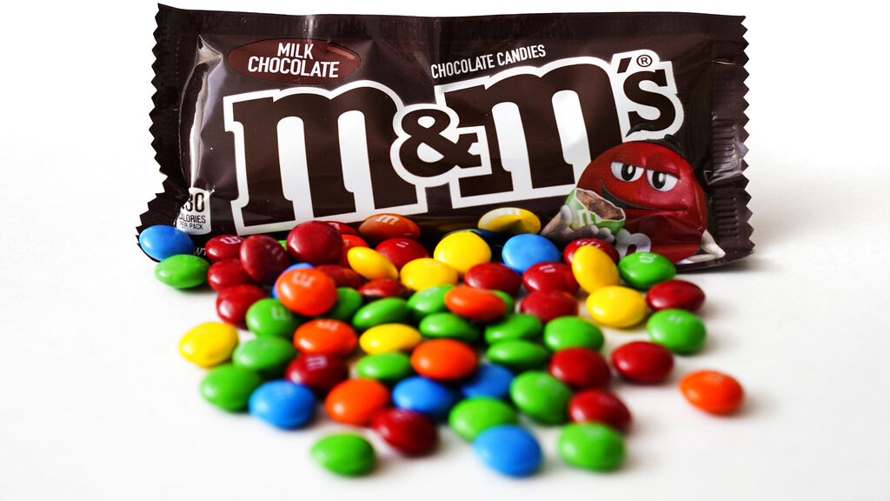
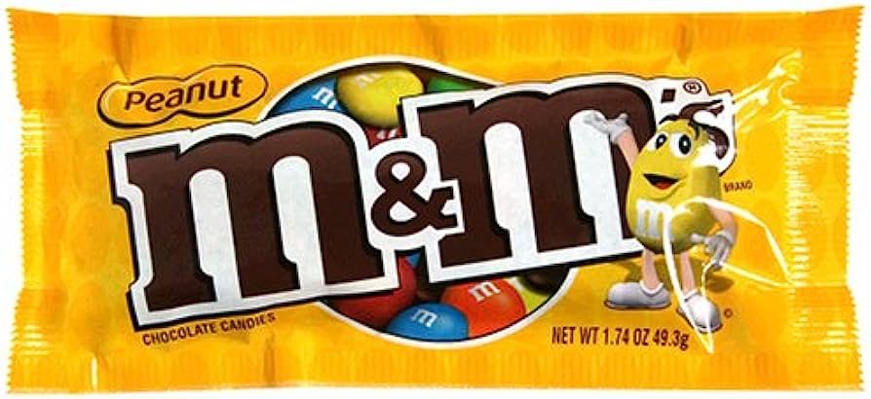
M&M’s

Slide 32
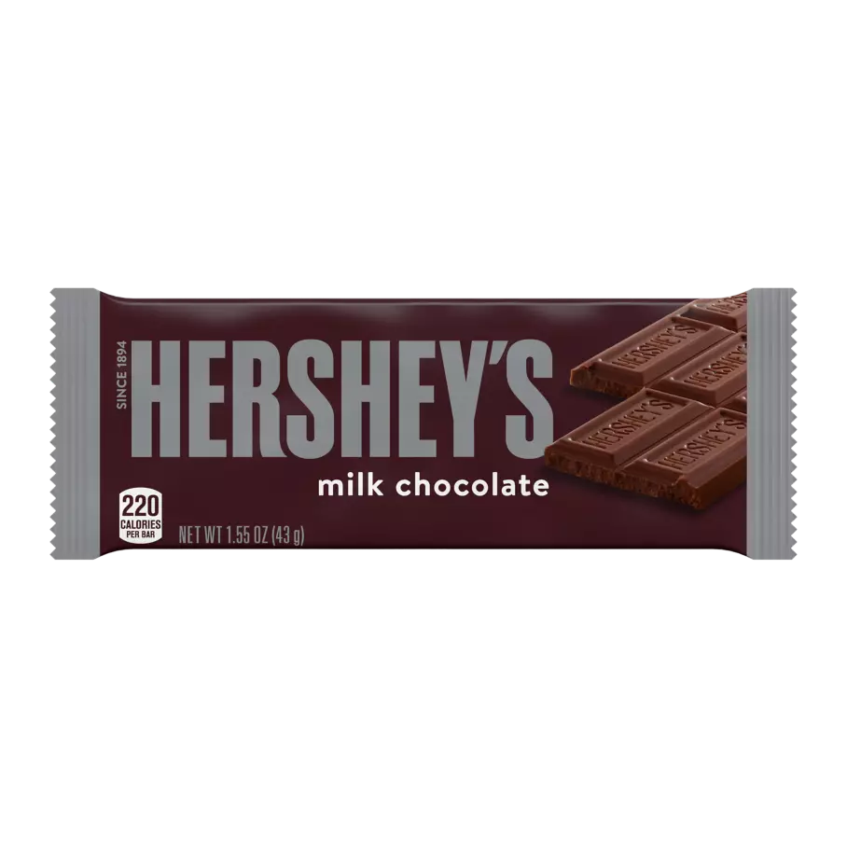
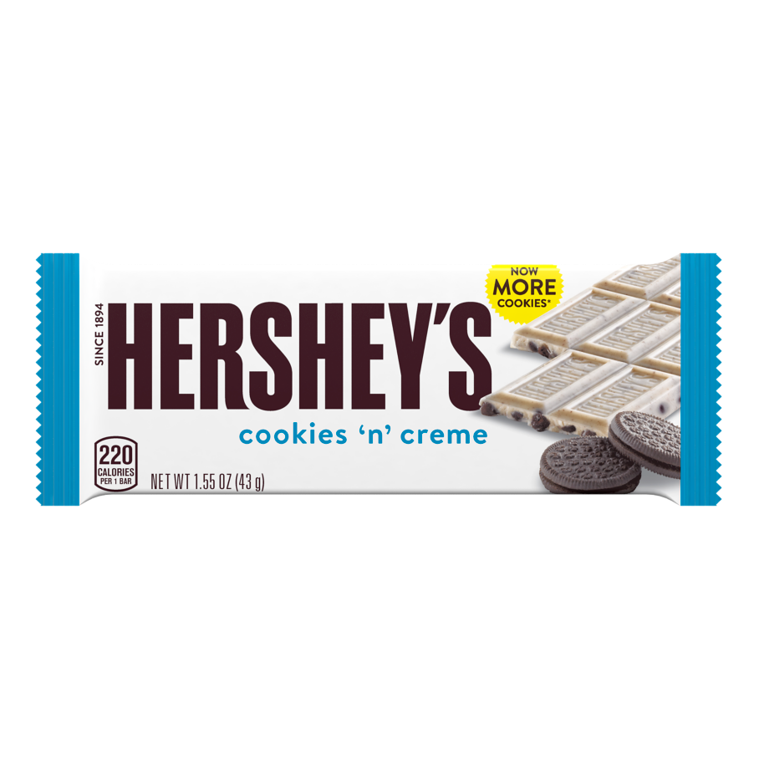
REGULAR HERSHEYS
COOKIES N CREME

Slide 33
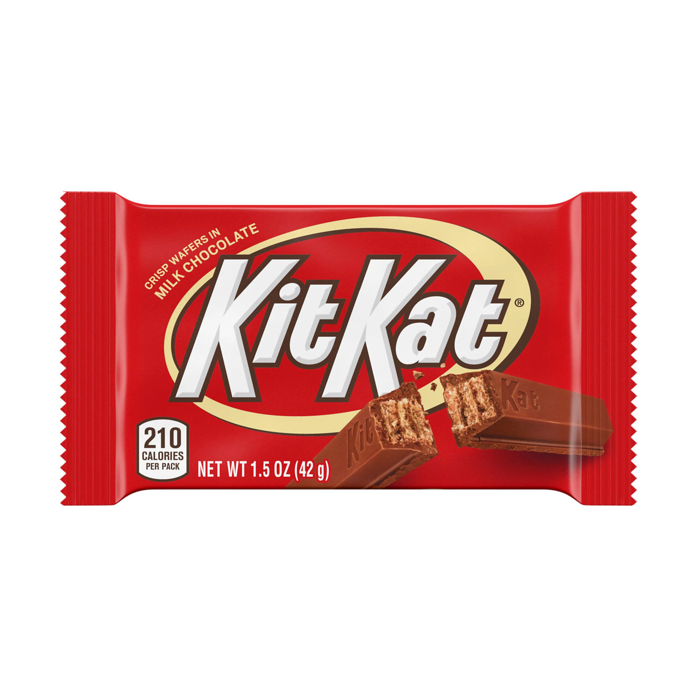

KIT KAT
TWIX

Slide 34
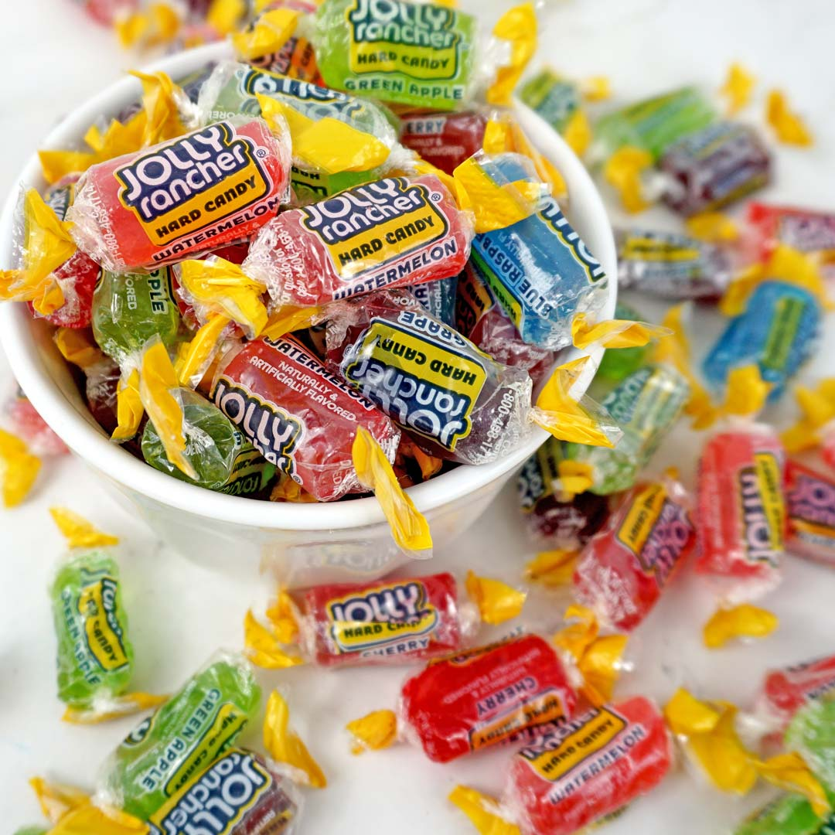
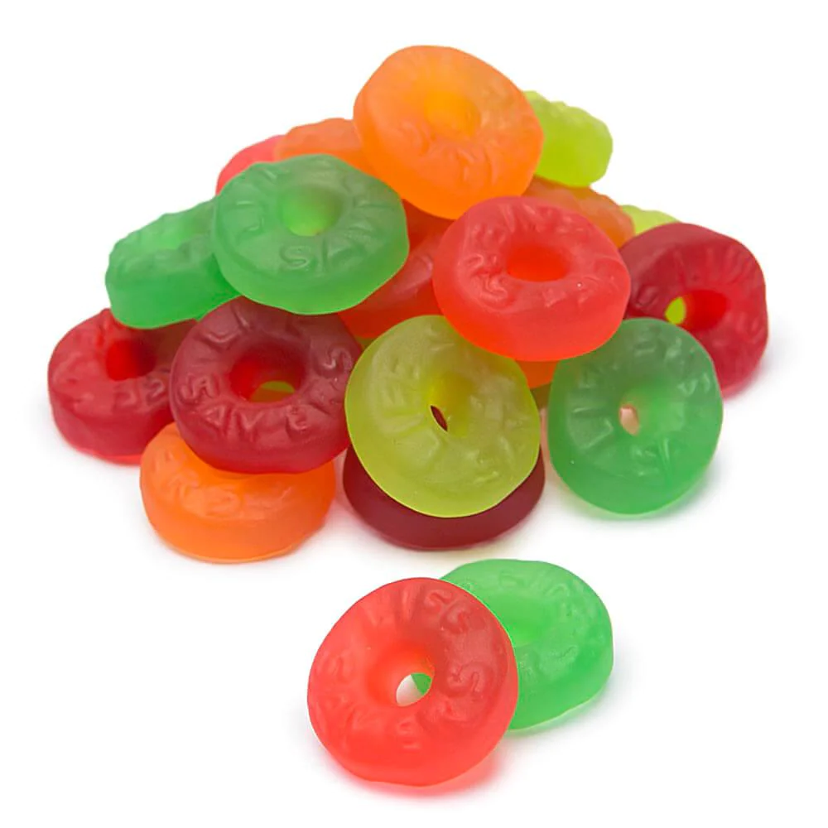
JOLLY RANCHER
LIFESAVER GUMMIES

Slide 35
GO TO CENTER COURT AND SIT DOWN.

